Slide 1

Attention is all you need
Calgary Deep Learning Fellowship
Ashish Vaswani, Noam Shazeer, Niki Parmar, Jakob Uszkoreit, Llion Jones, Aidan N. Gomez, Lukasz Kaiser, Illia Polosukhin
Hosted by Ted Edmonds
Presented by Morgan Payette
Github

Slide 2
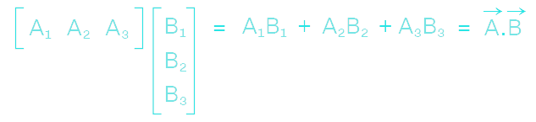
Dot Product
Sum of the elements-wise multiplication of 2 vectors
Results in a scalar value
This value is proportional to the cosine of the angle between the vectors
The dot product of 2 orthogonal vectors is 0
A·B=|A||B|cos𝜃
→ → → →

Slide 3
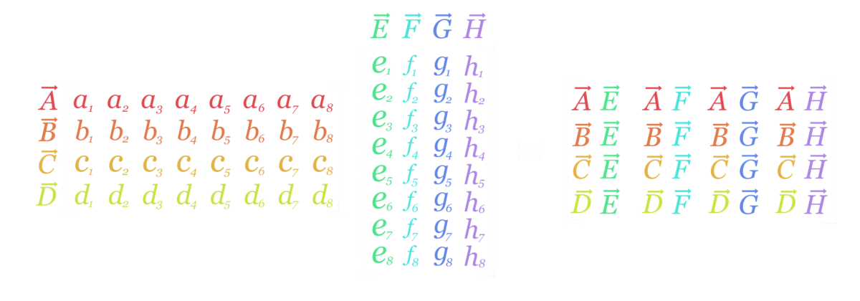
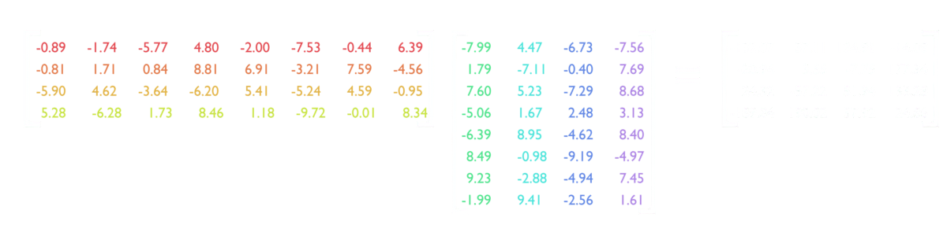
Matrix Multiplication
Matrix multiplication can be viewed as row vectors dotted with column vectors
This produces a matrix of scalars values that are proportional to cos𝜃

Slide 4
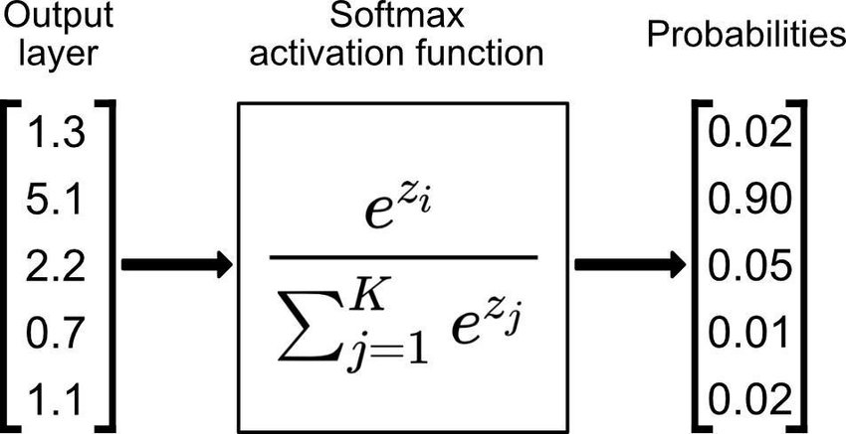
Softmax
Converts a vector of values into a probability distribution.
The sum of the values of the output vector will equal 1.
Input values of -infinity will become 0 when softmaxed.

Slide 5
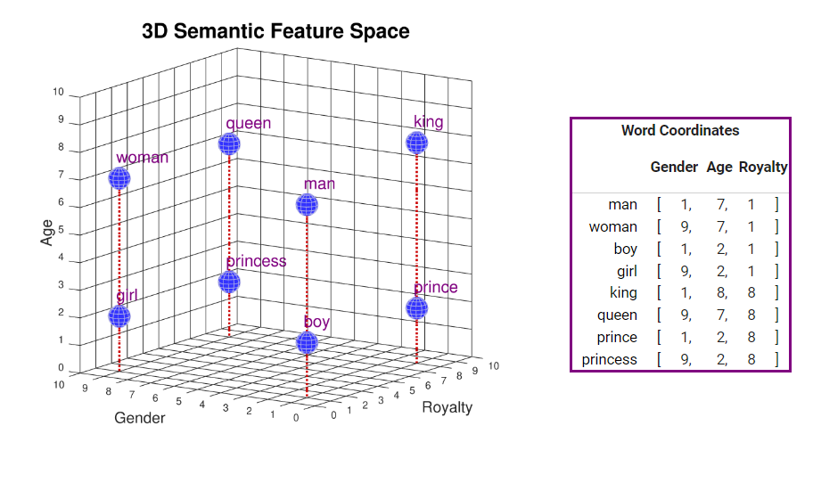
Word Embedding
Word embeddings are vector representations of specific words or tokens.
A word embedding aims to map words to a representation in semantic feature space.

Slide 6
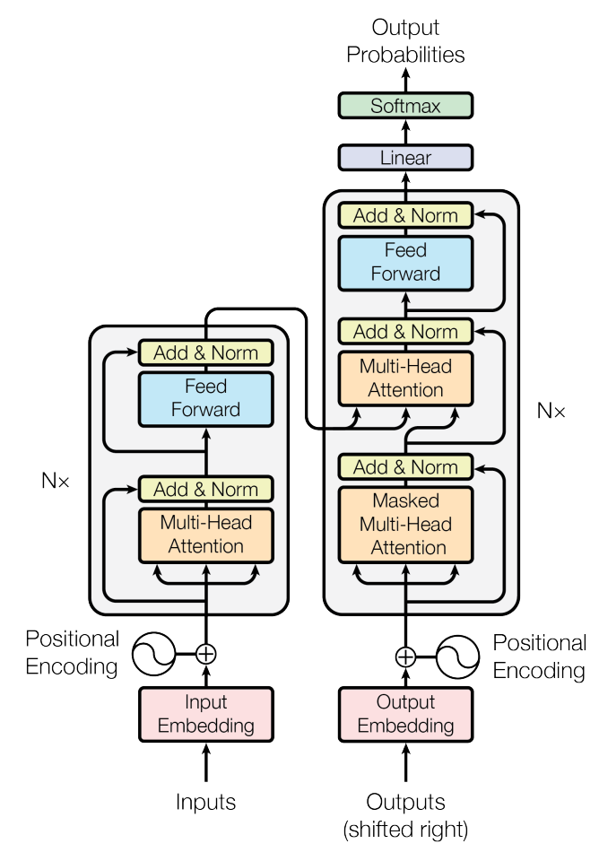
The Problem
Sequence transduction such as language prediction and machine translation require large amounts of context.
Previous industry standard models (RNNs and 1 dimensional CNNs) struggle with distant context.
Attention mechanisms helped effectively process distant context.
This paper presents the Transformer: A model based solely on the scaled dot product attention mechanism.

Slide 7
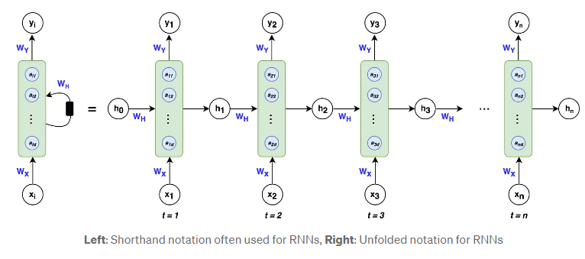
Problems with the Previous Methods
Recurrent Neural Networks (RNNs) process information sequentially.
This makes RNNs less able to parallelize.
The sequential nature of RNNs makes them vulnerable to the Vanishing/Exploding gradient problem.

Slide 8
The Transformer Model
To solve this, the transformer model was introduced. This model used attention only for machine translation.
Scaled Dot Product attention is used to weigh the importance of different tokens relative to one another.
Positional Encodings adds information about words position in the sequence to make up for the lack of recurrence.
Utilizes both self attention and cross attention.
Splits attention into multiple attention heads.

Slide 9
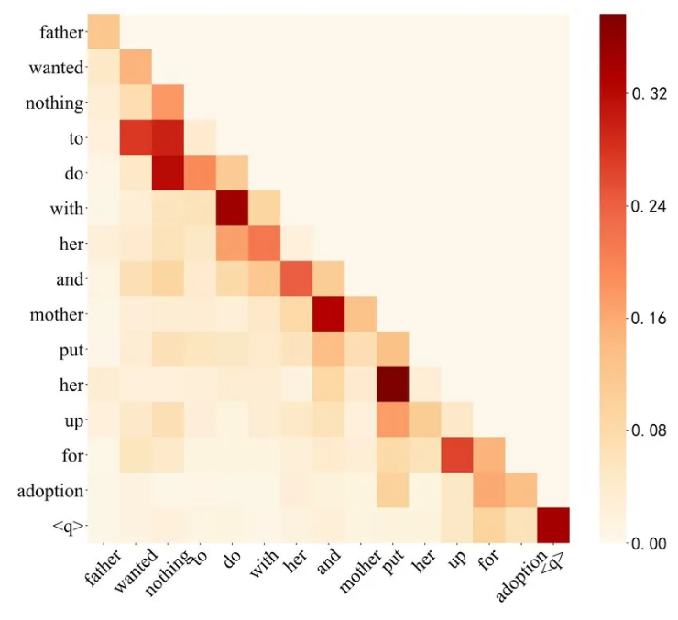
Attention Matrix
Allows the model to focus on relevant parts of the input sequence.
Generated via the dot product of key vectors and query vectors. Interpolated through value vectors.
Query (Q): Represent the elements for which attention scores are being calculated.
Keys (K): Represent what the queries are compared to while computing attention.
Values (V): Represent the data that should be aggregated from the attention scores to produce the output.

Slide 10

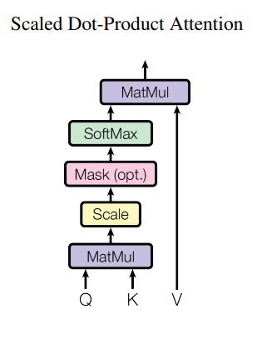
Scaled Dot Product Attention
Q : Matrix of Query vectors
K : Matrix of Key Vectors
d_{k} : Dimension of the K vector
V : Value Matrix

Slide 11
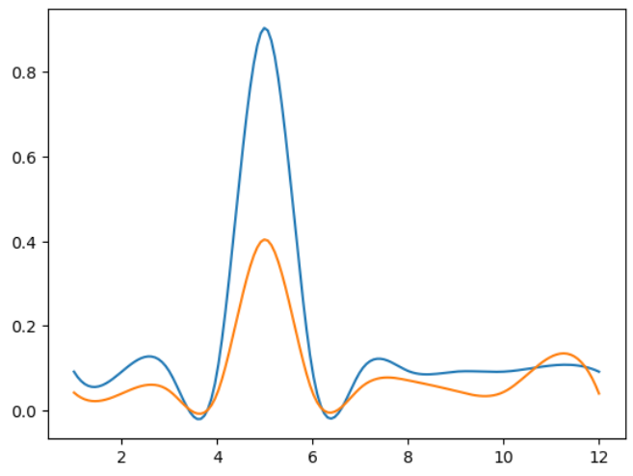
Why Scaled Attention
The softmax function can reach regions of extremely small gradients when the dimension of the input vector (d_{k}) becomes large.
This could be described as the output being overly “peaky”.
This can lead to some elements being under considered.
Scaling inversely proportional to the vector dimension helps ensure the network consider elements even for large values of d_{k}.
Blue: UnScaled Softmax
Orange: Scaled Softmax

Slide 12
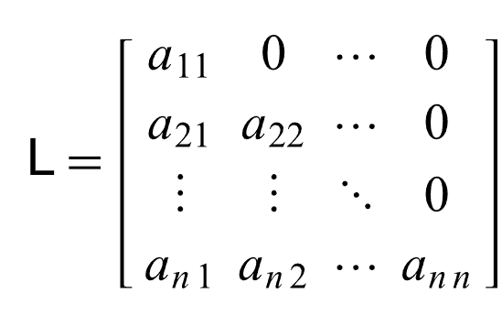
Self-Attention
Calculates attention between the input sequence and itself. This finds how much each element of the sequence influences one another.
All input tokens must be the same as output tokens.
During training the inputs must be masked with a lower triangular matrix to prevent the model “seeing” future tokens it should not have access to.
Lower Triangular Matrix

Slide 13
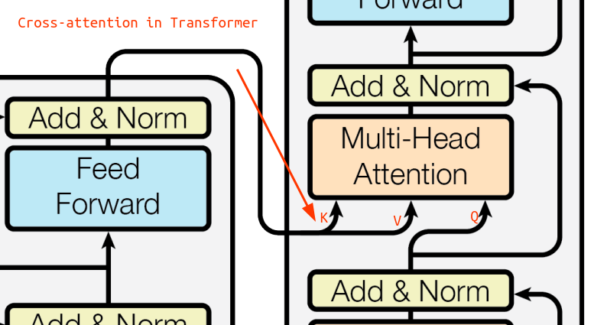
Cross-Attention
Calculates attention between an input sequence and a different input sequence.
These two sequences do not need to be made up of the same tokens (ie. English word tokens and French word tokens).
Keys and Values for cross attention come from the encoder.
Queries come from the decoder.
Cross Attention does not need to be masked, the model will have access to all cross attention tokens during inference time.

Slide 14
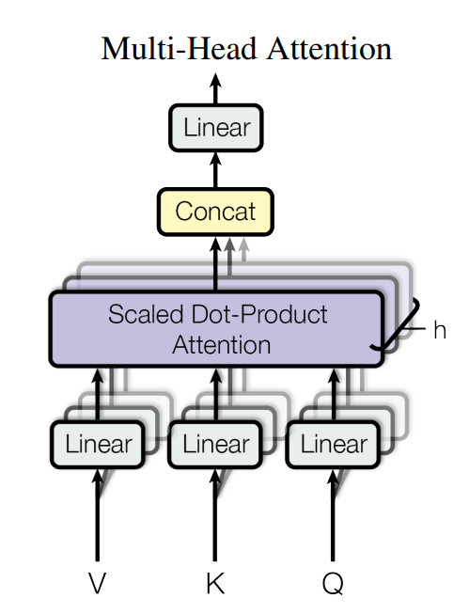
Multi-Head Attention
Rather than projecting to a single Query, Key and Value space, Multi-Head attention projects h times.
This allows a single attention block to attend to multiple features.
Each head in a Multi-Head attention block will use a head size that is one h^{th} the size of a single head attention block.
The outputs of each attention head are concatenated.
The concatenated result is projected one more time to create the attention block output.

Slide 15

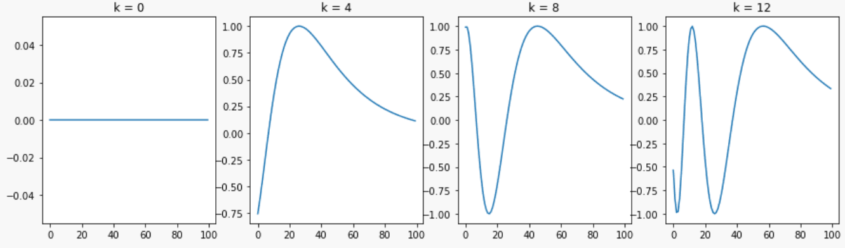
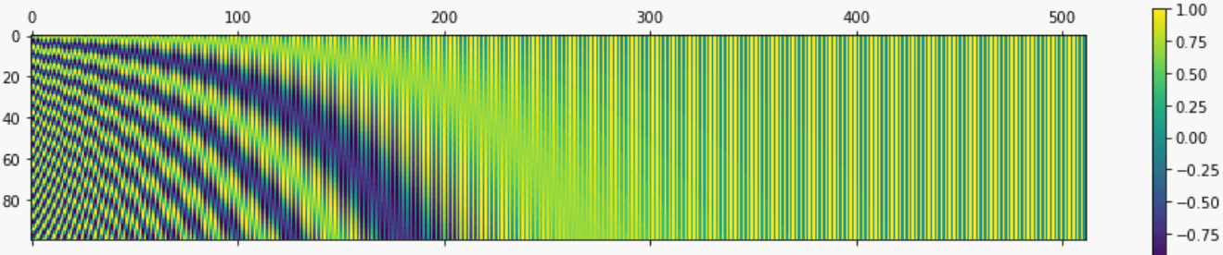
Positional Encoding
Other methods can infer the position of an element in the sequence via sequential processing (RNNs) or through convolutional filters (CNNs).
For an attention only network, this information needs to be injected.
dim(positional embedding) = d_{k}
Transformer networks uses sine/cosine embeddings, which are theoretically scalable to any length of input sequence.

Slide 16
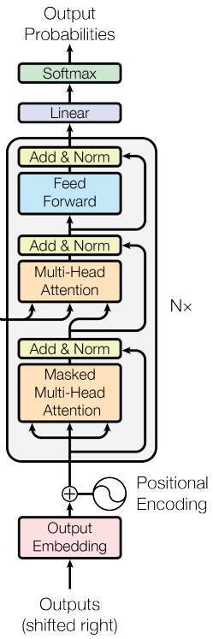
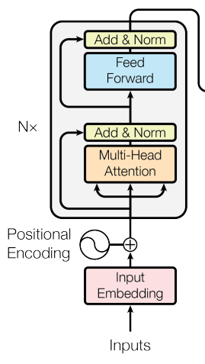
Transformer Architecture
Both encoder and decoder networks use an embedding size d_{k}=512, a block depth n=6, and a multi-head head count of h=8.
Input embedding of translated text sequence.
Positional Encoding
Decoder block:
Multi-Head Self Attention (masked).
Residual Connection and Layer Normalization
Multi-Head Cross Attention.
Residual Connection and Layer Normalization
Dense Layer
Residual Connection and Layer Normalization
Dense “Unembedding” Layer
Softmax probabilities.
Input embedding of untranslated text.
Positional Encoding
Encoder block:
Multi-Head Self Attention
Residual Connection and Layer Normalization
Dense Layer
Residual Connection and Layer Normalization

Slide 17
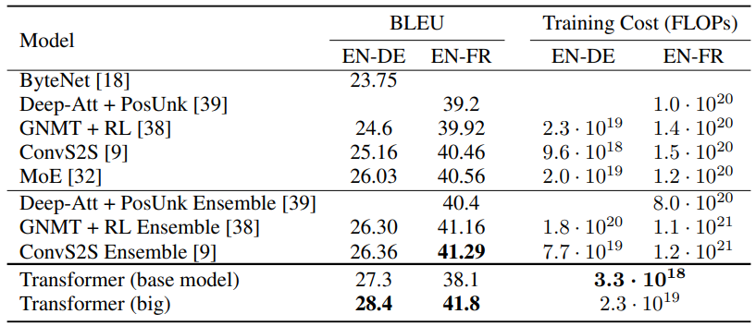
Training and Results
Datasets:
4.5M English-German sentence pairs.
36M English-French sentence pairs.
Trained on 8 Nvidia P100 GPUs
Adam optimizer with betas=(0.9,0.98)
Evaluated using BLEU scores.
Above, BLEU and estimated training cost of the Transformer relative to previous methods.
Transformer (base model) uses the parameters described previously. Transformer (big) changes d_{k}=1024, and h=16.

Slide 18
References
https://arxiv.org/abs/1706.03762
https://www.cuemath.com/algebra/dot-product/
https://www.researchgate.net/figure/Working-principles-of-softmax-function_fig3_349662206
https://www.cs.cmu.edu/~dst/WordEmbeddingDemo/tutorial.html
https://medium.com/@AIExplainedML/how-does-the-attention-mechanism-in-gpt-models-work-5f489a59346b
https://mathworld.wolfram.com/LowerTriangularMatrix.html
https://machinelearningmastery.com/a-gentle-introduction-to-positional-encoding-in-transformer-models-part-1/

